Slide 1
Class Format
Synchronous vs Asynchronous
Face-to-face (In Person) vs Remote
We are always synchronous
We will be face-to-face Mondays and Wednesdays and remote on Friday.
My expectation is that you will be here in person Mondays and Wednesdays. If you need to be remote Monday or Wednesday, we understand but please be respectful of your classmates and make every effort to attend in person.
Priorities:
Health and safety
Effective teaming and association
Intended course schedule

Slide 2
Introductions

Slide 3
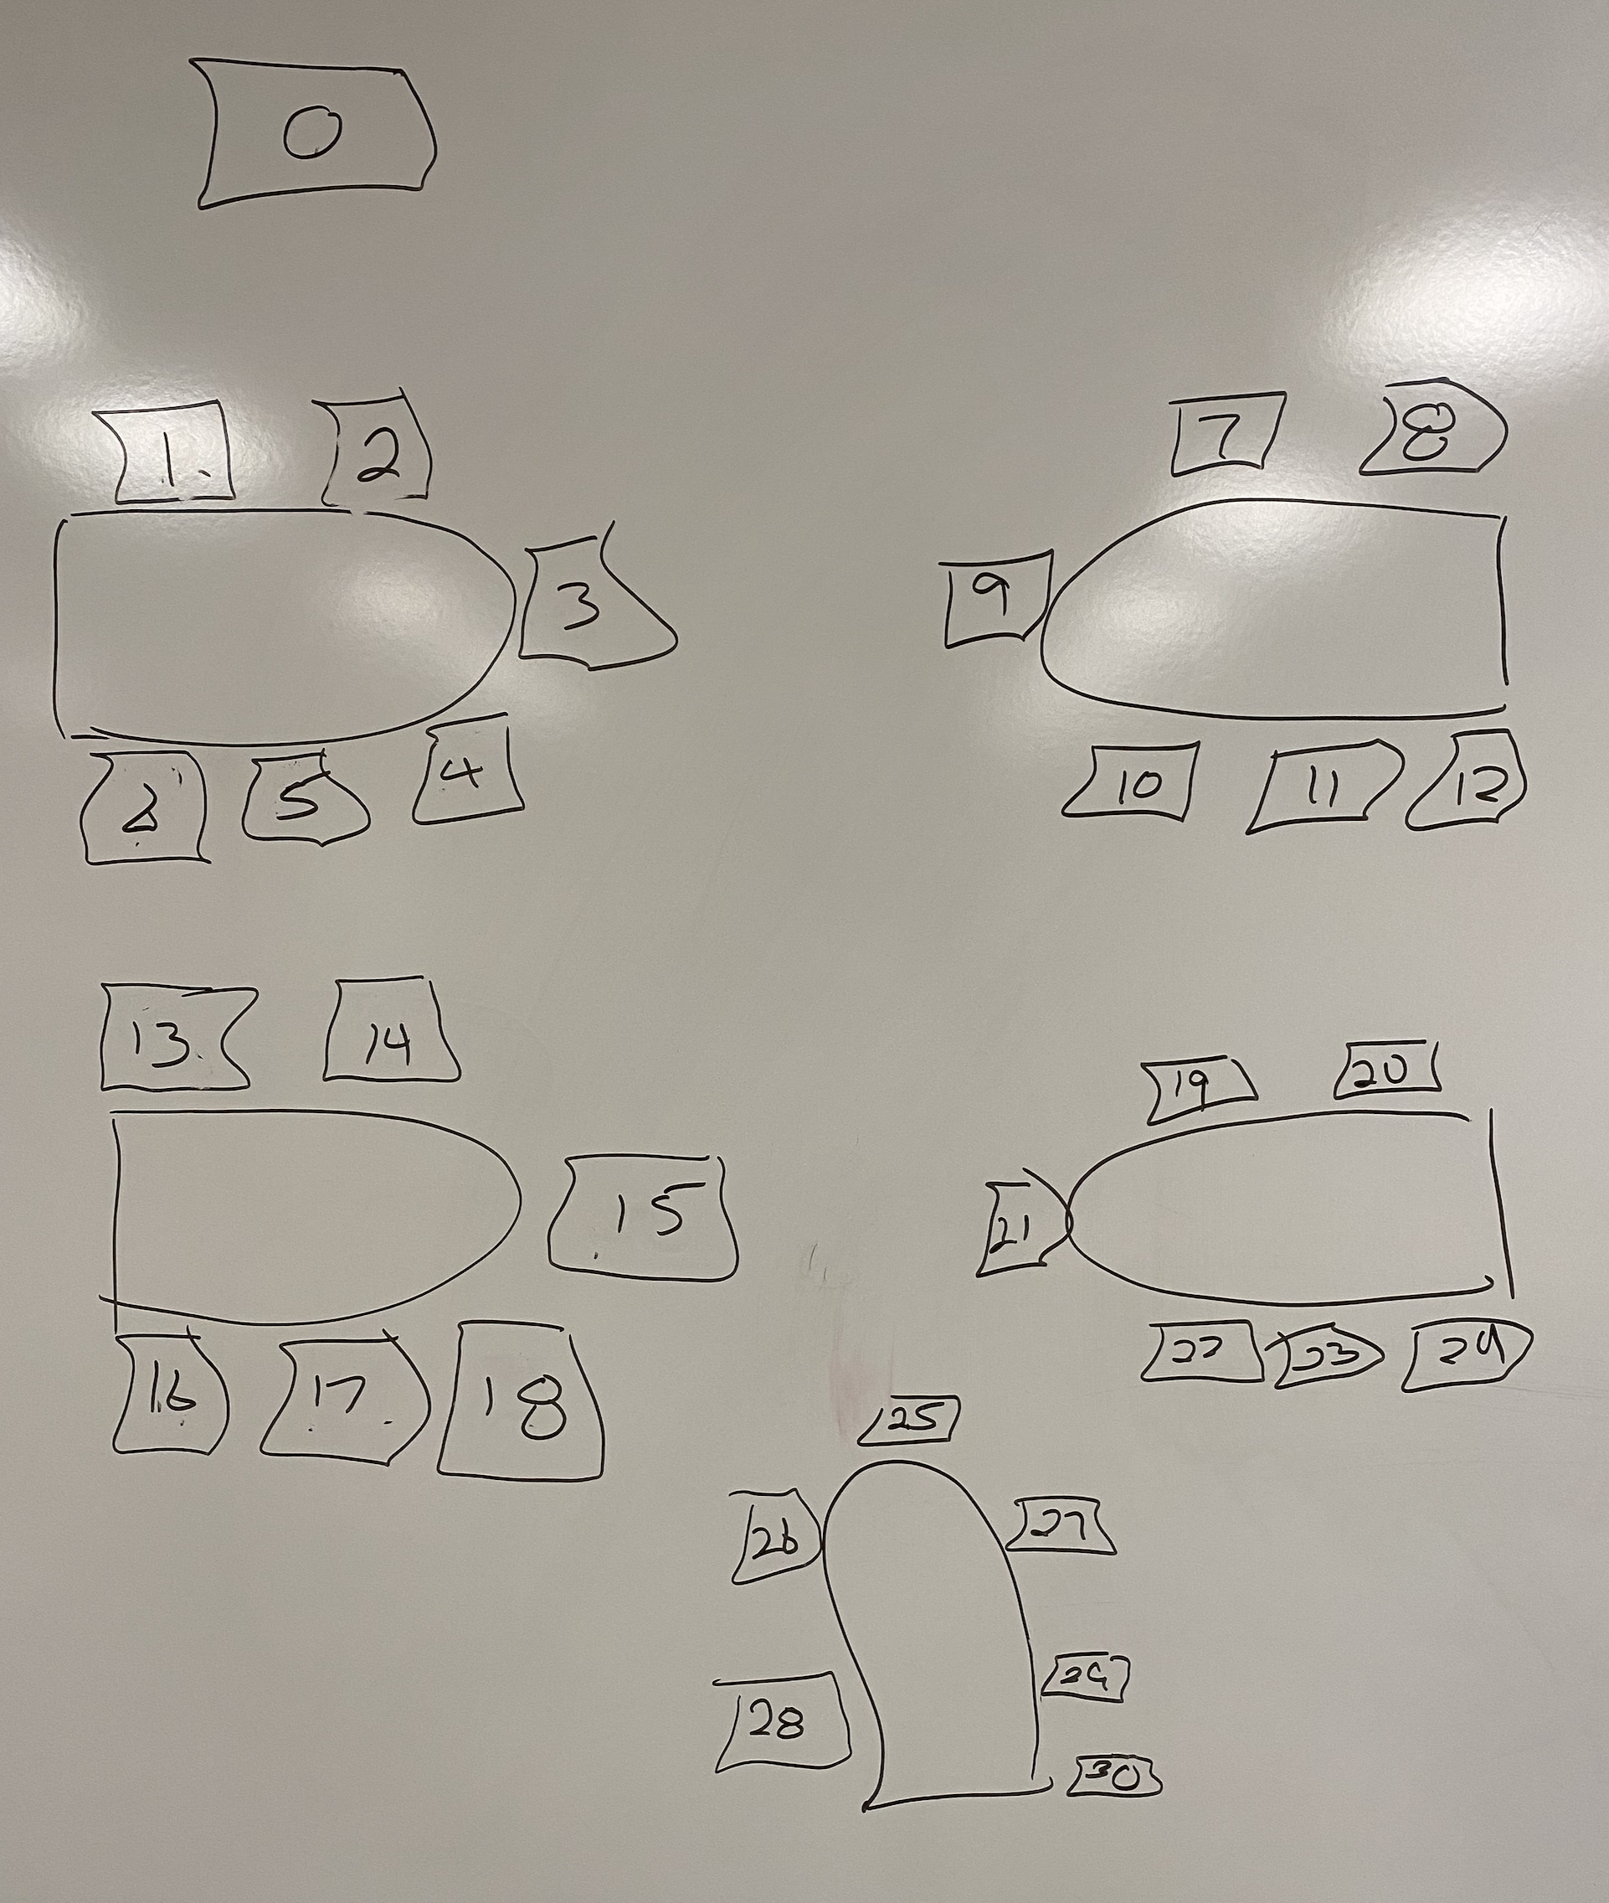
Foreshadowing Your Introductions
Be prepared to share your:
Full & Preferred Name
Seat Number and Row in spreadsheet
Major / Minor
Programming Experience (1 to 5)
An interesting fun fact about yourself
Favorite “adjective/noun” scrum team name
Are you willing to be your team’s initial Scrum Master?

Slide 4
Scrum Team Names
Scrum team names from previous semesters:
EZScrumEZGo
SourPatchEngineers
DreamRaccoons
TeamFun
SwagMoney
MonaLisas
Scrumdiddlyumptious
FightingBass
TitanicSwimTeam
GloriousKenobis
RedDragons
ScrumciousCoders
Mongooses
Scrumples
WubbaLubbaDubDubs
RedPandas
SpiderScrum
MadSanitizers
SpeedCoders
StingyTadpoles
BlueThrees
PurpleCobras
ScruptyDupty
LaughableCaterpillars
PurplePirates
ScrumIsFum
ScrummyScrumbags
TheCrew
WickedCrew
SpicyChalupa
ScrumOfTheEarth
LightningMcQueen
Notes:
Hand out name tags and introduction forms before Syllabus Overview

Slide 5
Introductions – Part 1

Slide 6
Introductions
Full and Preferred Name:
Eric Pogue
Eric, Mr. Pogue, or Professor
Family, Home, College background:
Married with five children, relocated from Davenport, IA to Chicago area
Undergraduate in CS and Masters in Business… teaching evenings for many years
Programming experience:
Decades in the industry as a developer, architect, project manager, division manager, and vice president of various software development organizations
Part of many teams that have delivered products to ten’s of millions of customers globally
Parsons Technology, Intuit, The Learning Company, Jasc Software, and John Deere
… and most recently working on a startup product “Stadia” with my oldest son
This is my third year teaching full-time

Slide 7








Slide 8
Introductions
Likely programming environment
MacOS, Terminal, Visual Studio Code, and Chrome/Firefox web browser
Top two or three things that you would like to get out of this class
To learn something myself while helping each of you be successful
Motivate you to look deeper while we are exploring technologies and process
Help you build something that makes you proud
Hobbies:
Wilderness Canoeing & Camping (Quetico) and Triathlons
Fun Fact:
At one point I had the very dubious “honor” or being the most traveled John Deere employee to India with 40+ trips over a 5-6 year period while setting up the 400+ person John Deere Technology Center – India Software Development organization.
Notes:
Vanity

Slide 9
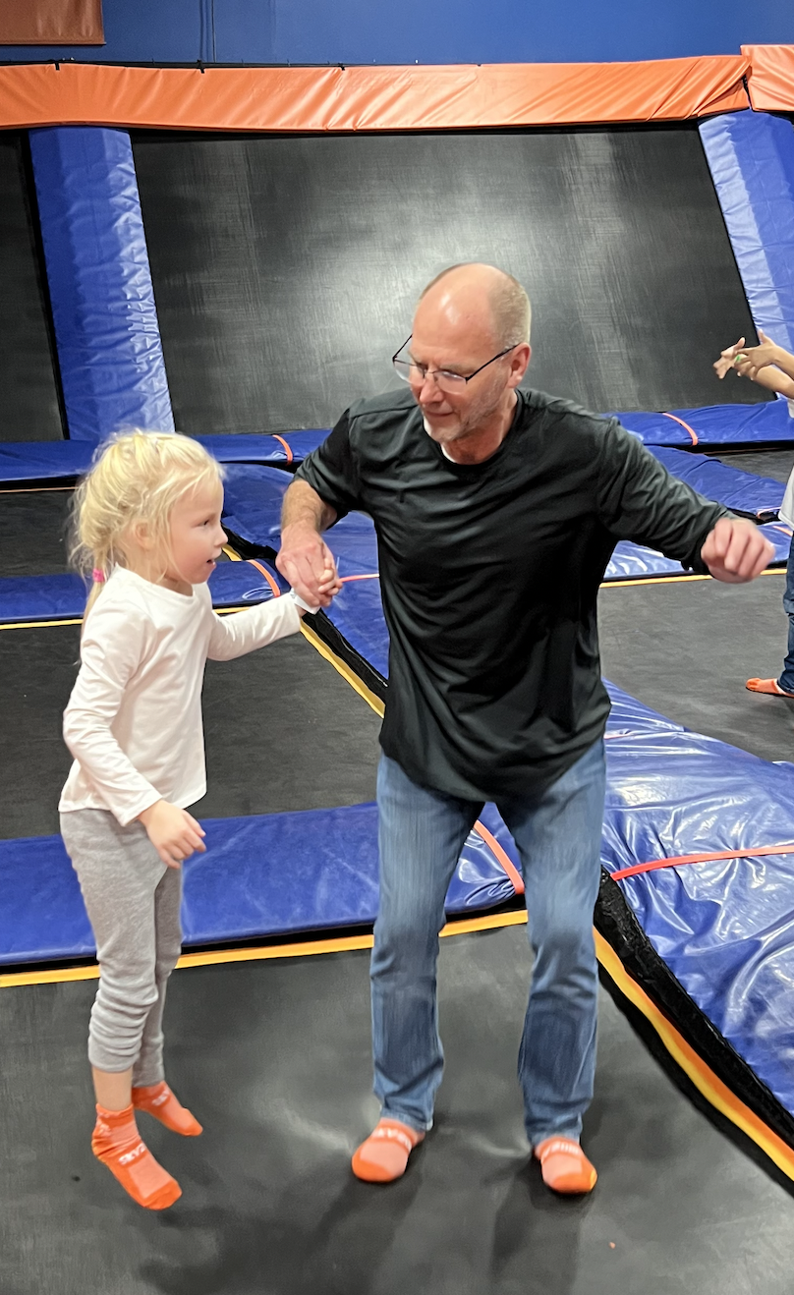

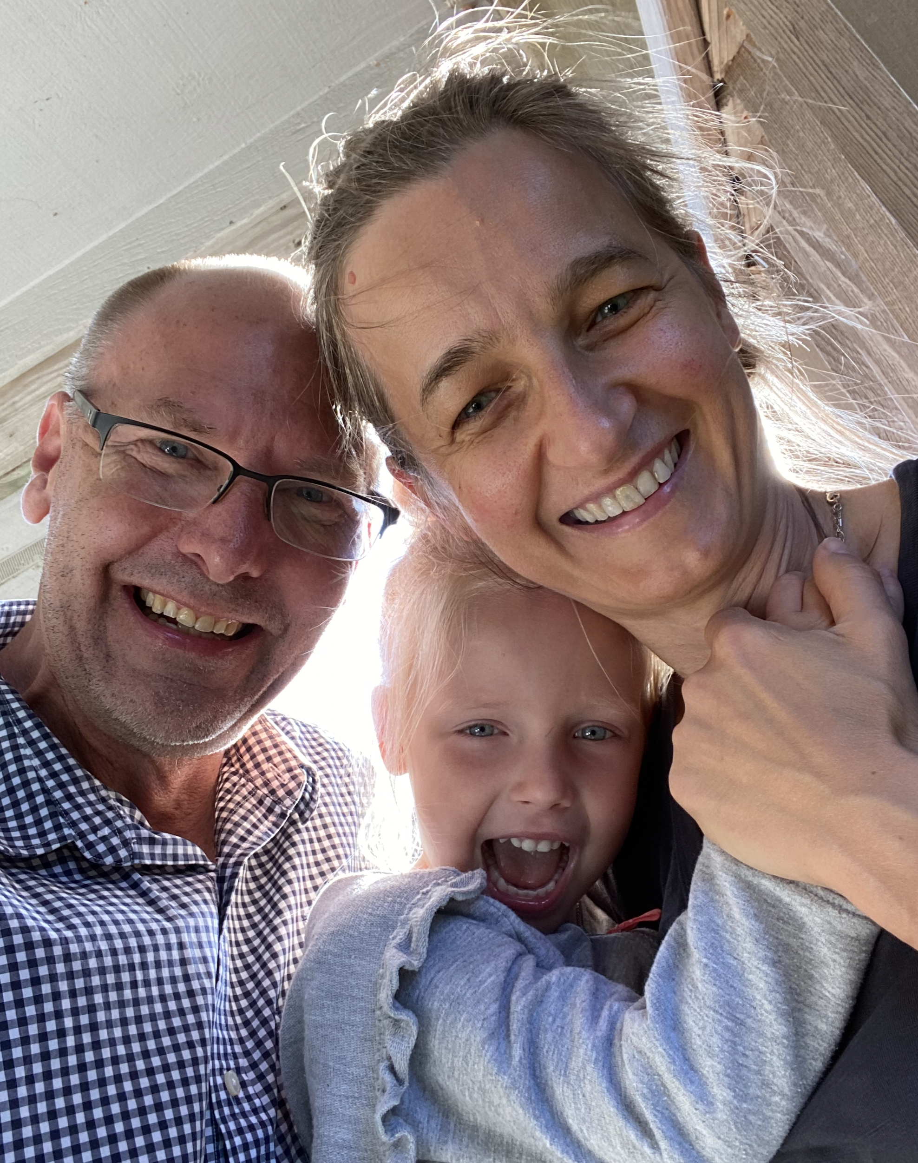
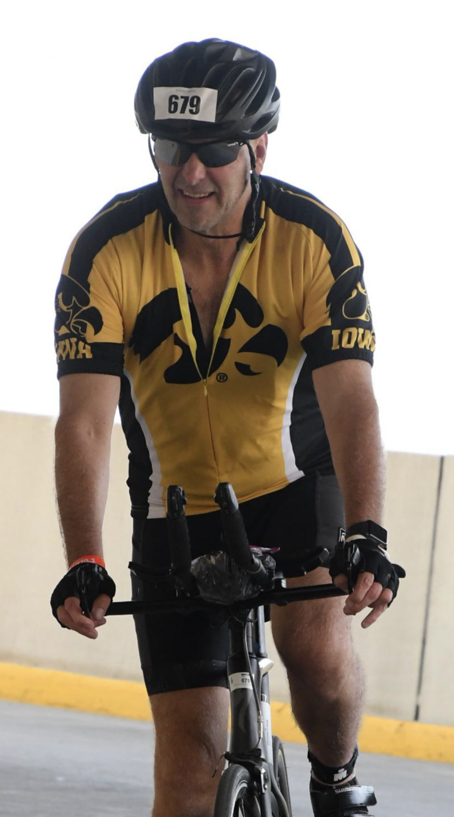
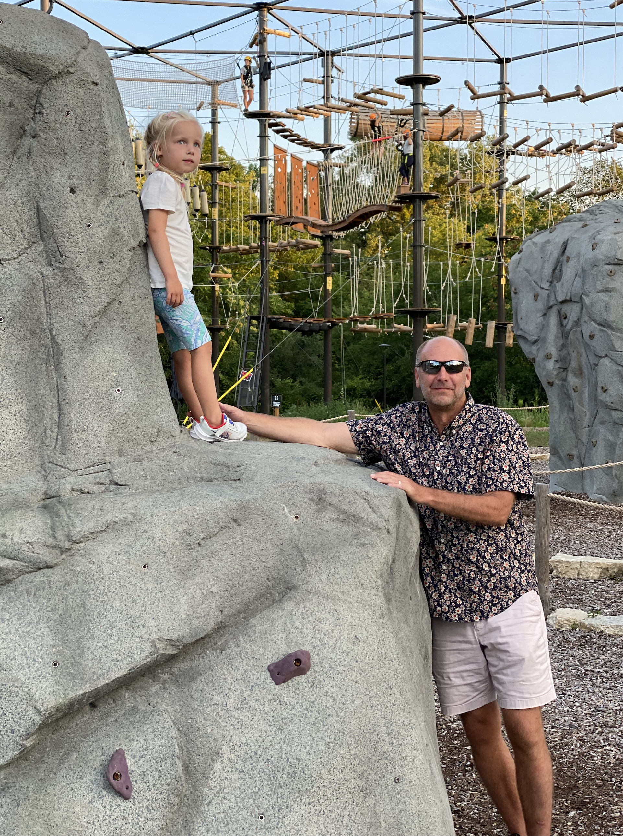
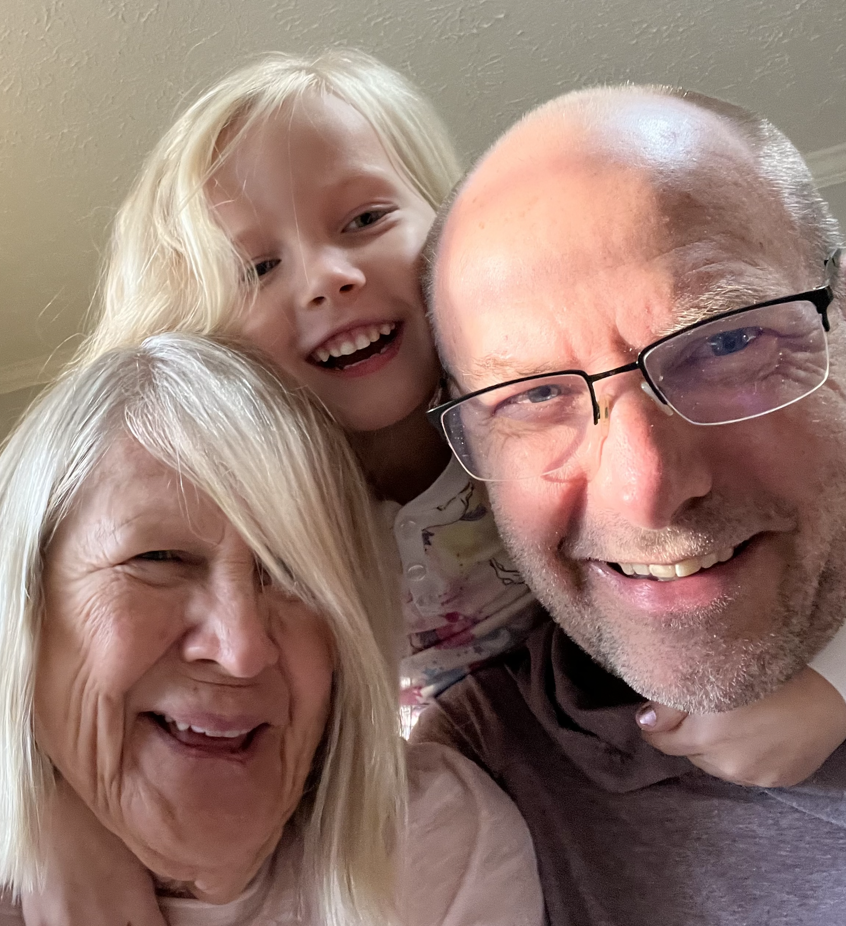


Slide 10
Sprint 1 Planning (abbreviated)

Slide 11
Sprint Planning
We will be doing sprint planning at the beginning of each of our 8 sprints during the semester.
What’s different about Sprint 1 planning?
This is our first time doing spring planning
We will need to finish Sprint 1 planning on Wednesday because we want to make sure that we have time for Introductions and initial Scrum Team assignments today
Next Monday is a holiday so we will be missing one class session this sprint

Slide 12

Scrum Process – Sprint Planning
By Dr ian mitchell - Own work, CC BY-SA 4.0, Link

Slide 13
Review Announcement, Activities List,
Assignments, and Syllabus

Slide 14
Sprint Planning
(to be continued Wednesday)

Slide 15
Introductions – Part 2

Slide 16
Scrum Team Names
Scrum team names from previous semesters:
EZScrumEZGo
SourPatchEngineers
DreamRaccoons
TeamFun
SwagMoney
MonaLisas
Scrumdiddlyumptious
FightingBass
TitanicSwimTeam
GloriousKenobis
RedDragons
ScrumciousCoders
Mongooses
Scrumples
WubbaLubbaDubDubs
RedPandas
SpiderScrum
MadSanitizers
SpeedCoders
StingyTadpoles
BlueThrees
PurpleCobras
ScruptyDupty
LaughableCaterpillars
PurplePirates
ScrumIsFum
ScrummyScrumbags
TheCrew
WickedCrew
SpicyChalupa
ScrumOfTheEarth
LightningMcQueen
Notes:
Hand out name tags and introduction forms before Syllabus Overview

Slide 17
Foreshadowing Your Introductions
Be prepared to share your:
Full & Preferred Name
Seat Number and Row in spreadsheet
Major / Minor
Programming Experience (1 to 5)
An interesting fun fact about yourself
Favorite “adjective/noun” scrum team name
Are you willing to be your team’s initial Scrum Master?

Slide 18
Switch Slide Decks

Slide 19
End of Session

